Slide 1
Hackers Anonymous
Sprint 1 Review

Slide 2
About Us
Evan Lavertu (Scrum Master)
Cody Coleman
Jack Fitzgerald
Kareem Youssef
Patrick Keleher

Slide 3
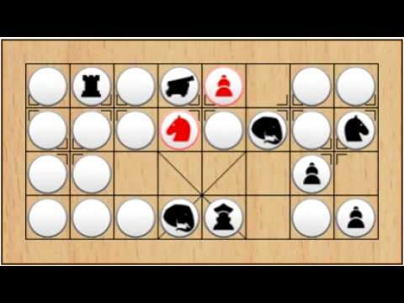
Banqi

Slide 4
Banqi - Overview
32 Spaces
32 Game Pieces
16 per player
All pieces start face down
All game piece locations randomized
No team sides
Objective: Capture all of your opponents game pieces

Slide 5









Tools

Slide 6
Team Tools
Discord
Communication
GitHub
Version Control
https://github.com/elavertu9/cs414-f18-001-HackersAnonymous
Google Drive
Scrum Notes
ZenHub
Scrum Software
Notes:
Outline of team tools

Slide 7
Front End Tools
Vue.js
Client Side Framework
Node.js
Dependency Management (npm)
Application Development
Notes:
Outline of client side tools

Slide 8
Middleware Tools
Swagger
API Creation Tool Kit
Notes:
Outline of middleware tools (between client and server)

Slide 9
Back End Tools
Java
Language of choice
Maven
Build Management
MySQL
Database
Notes:
Outline of tools used on the server

Slide 10
Sprint 2 Goal
Playable game in simplest form
Notes:
Overview of user stories being implemented in Sprint 2

Slide 11
Playable Game
User: I would like to play the game on a board with 8 x 4 squares.
User: I would like to be able to move my game pieces.
User: I would like to be able to capture enemy pieces.
Capture must be a valid move on the game board.
Player may only capture a face up piece of the opposing color.
The board presented is 8 x 4 squares.
Movements restricted to 8x4 game board.
Player may only move a piece of their own color.
All pieces move identically.
Piece may not move onto an occupied square unless it’s a legal capture.
Notes:
Slide for playable game user stories

Slide 12
Playable Game
User: I want game pieces to disappear when they are captured.
User: I would like to be able to flip over a game piece for my turn.
User: I would like the initial game board state to be randomized.
Captured game piece no longer visible on game board.
Game board location of capture game piece occupied by attacking piece.
Game piece can not be flipped over if it is already face up.
Pieces appear face down and their locations are randomized.
Notes:
Slide for playable game user stories

Slide 13
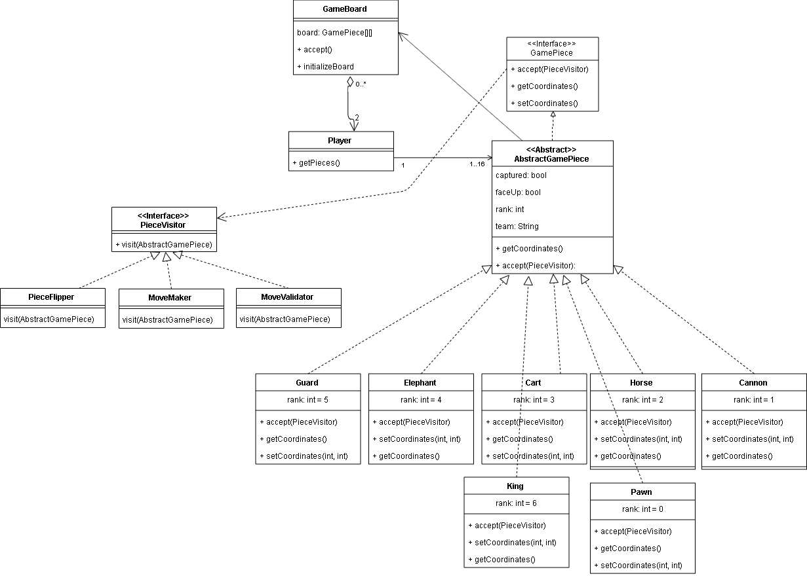
Class Diagram
Notes:
Slide for class diagram

Slide 14
Sprint 1 Review
What went well?
Plans for Sprint 2
Notes:
Outline of tools used on the server

